Slide 1
New Technology Applications in Design Teaching and Research,
Department of Design, University of California at Davis
Christina Cogdell, Ph.D.
Former Chair & Professor of Design
UC Davis
For Technology Exploration International Symposium
ExploraTec, Universidad del Desarrollo, Concepción, Chile

Slide 2
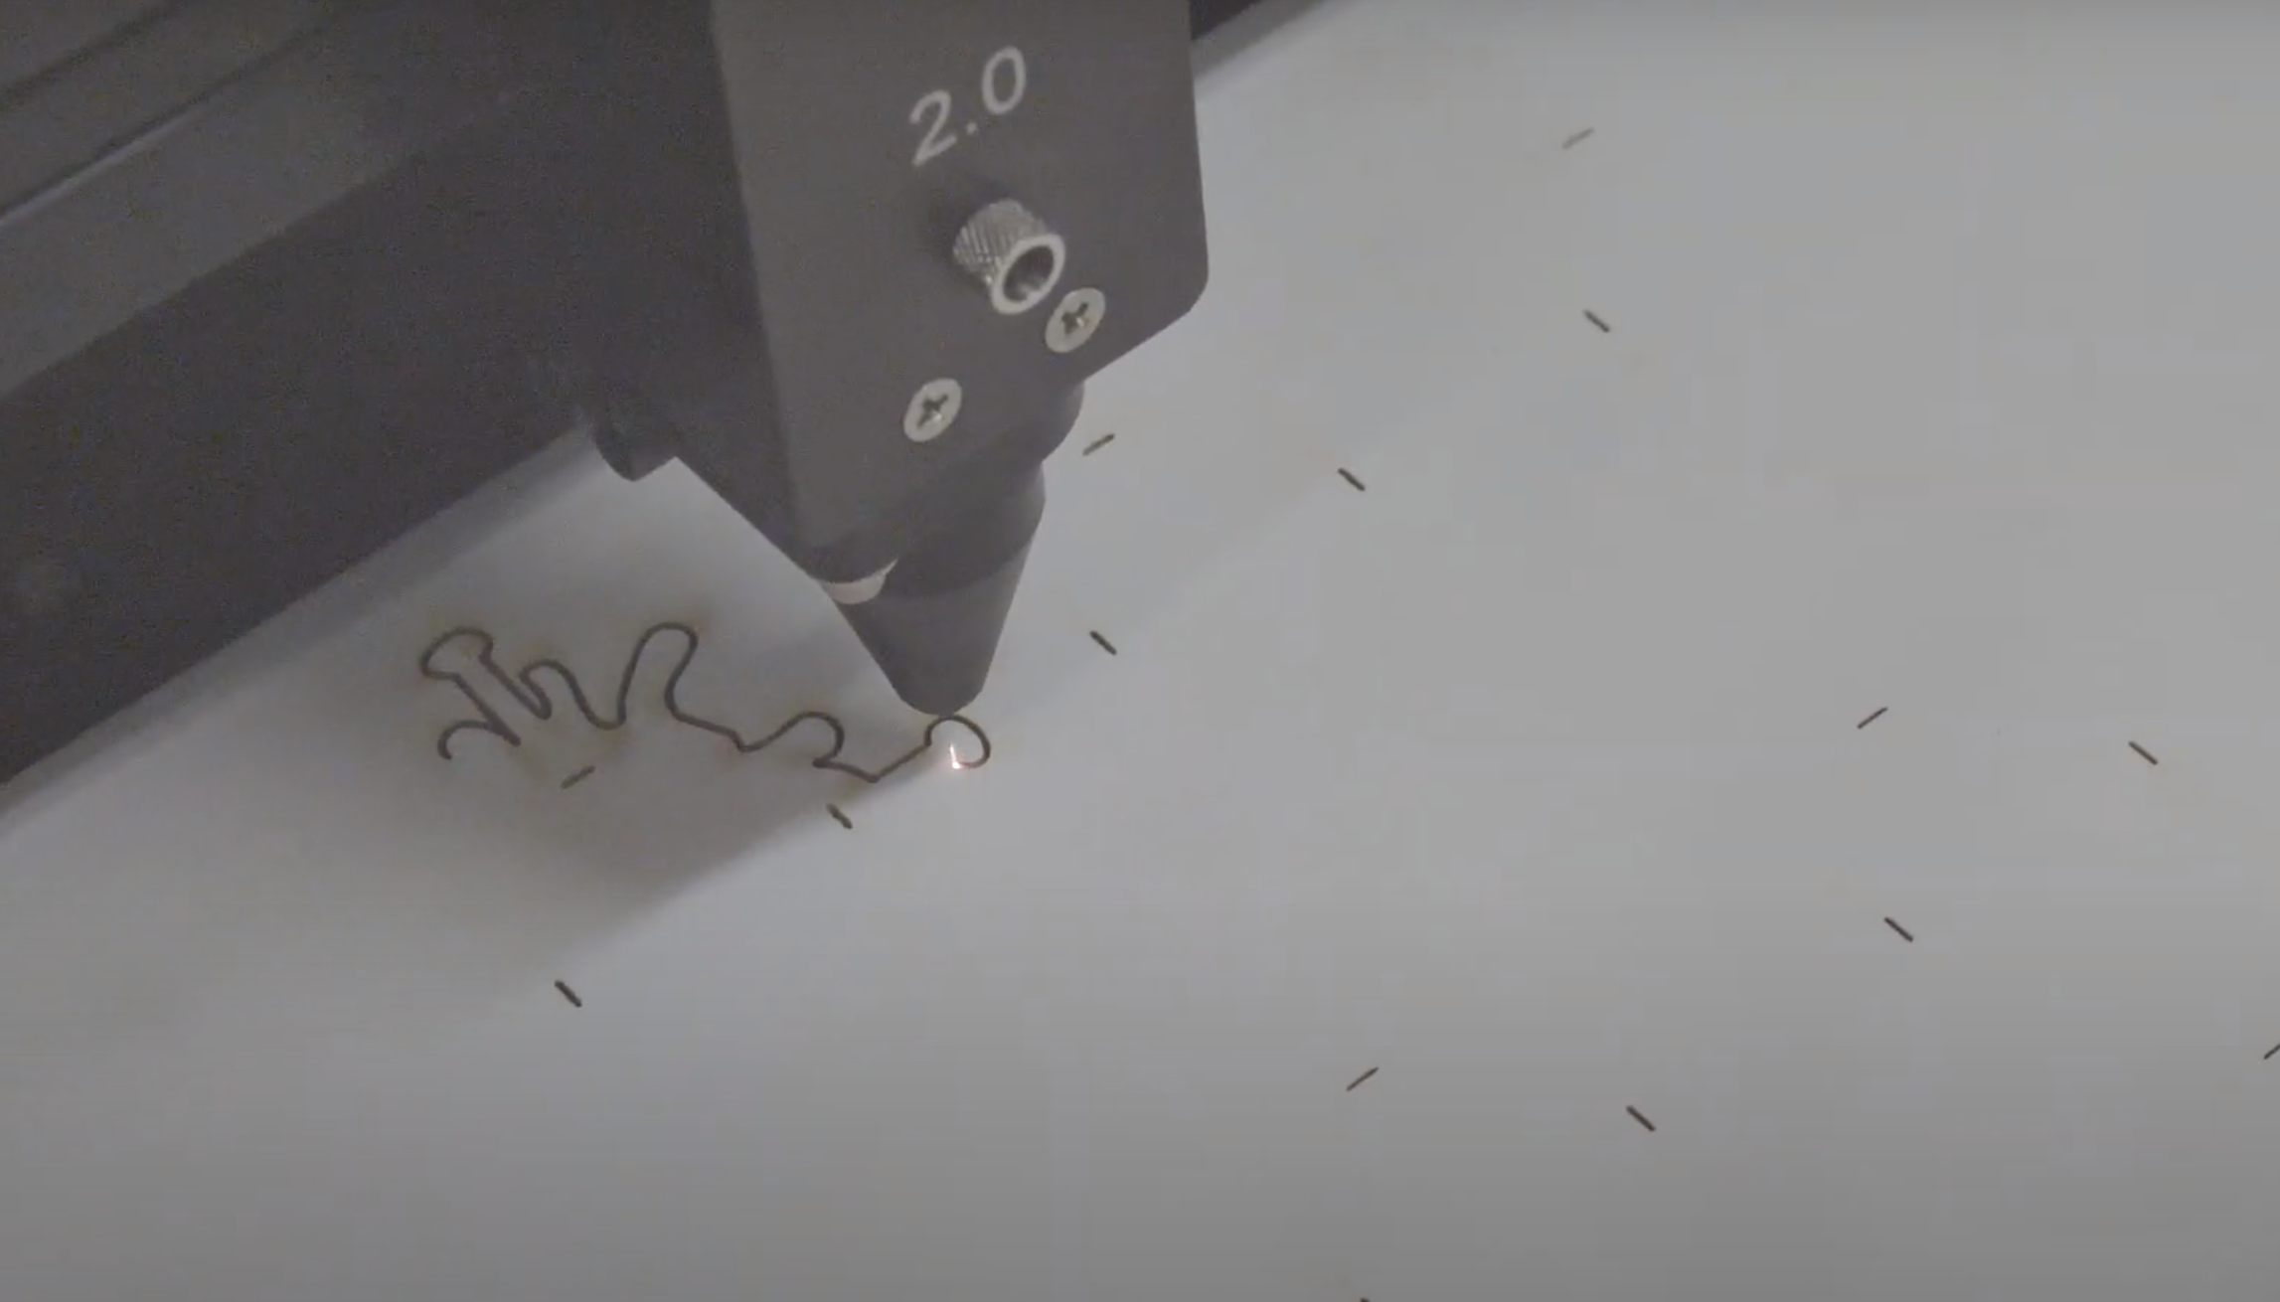
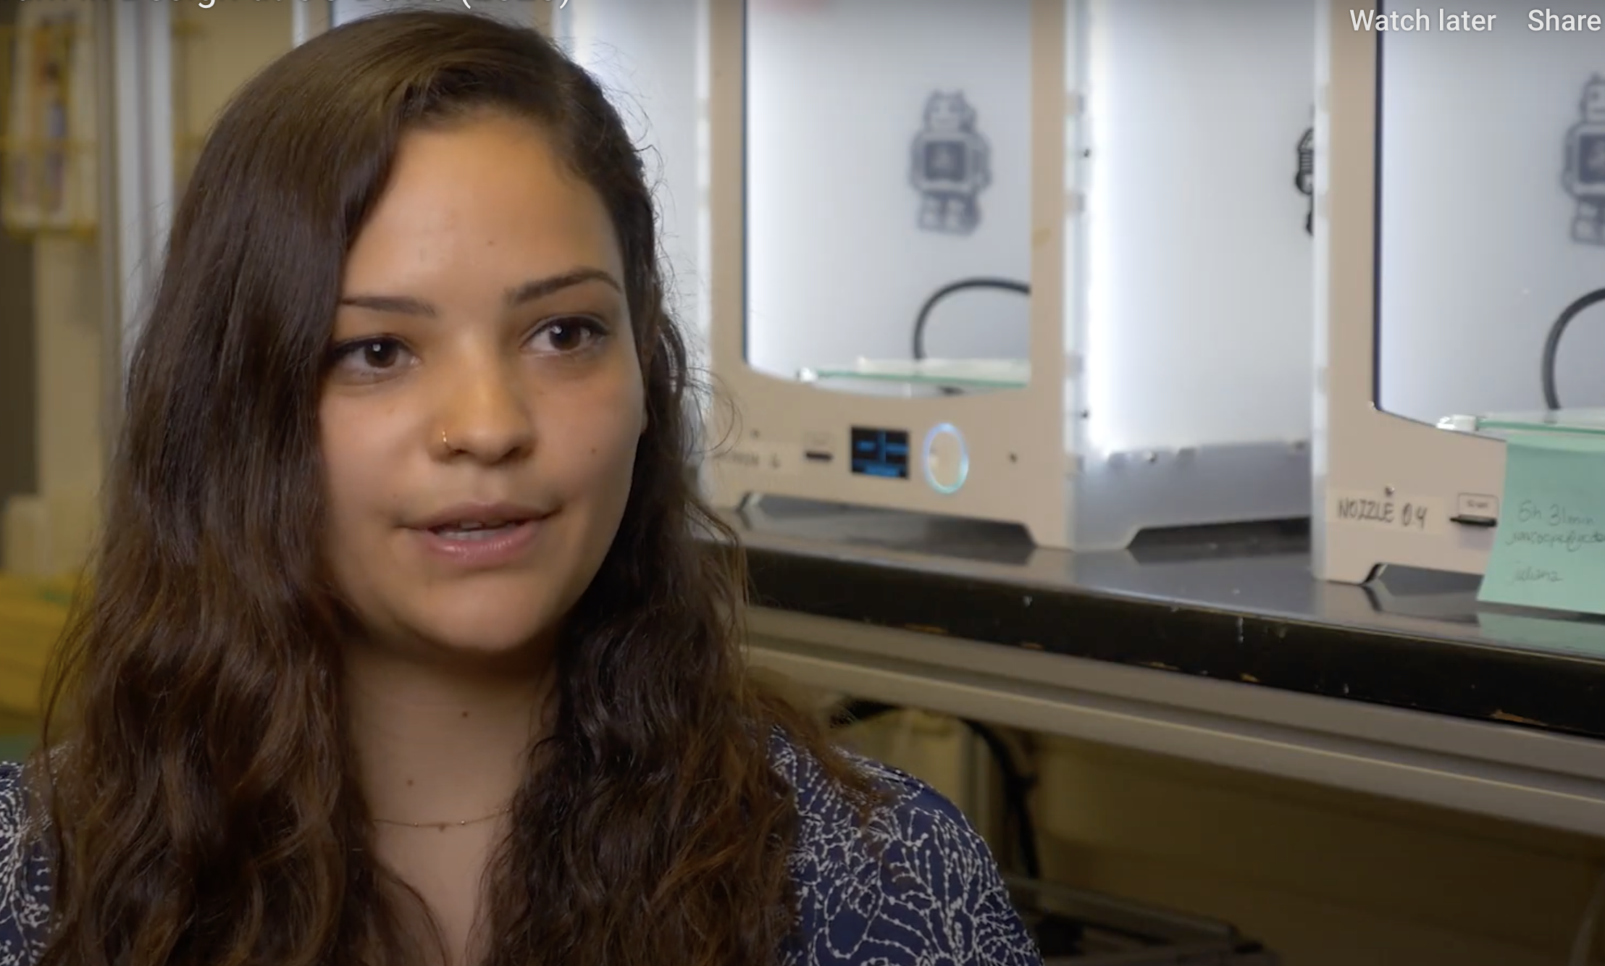
Department Overview 2008
100 undergraduate majors
0 graduate MFA students
9 ladder faculty, 3 continuing lecturers
Makerspaces: Woodshop, Textiles dye lab
Department Overview 2020
800 undergraduate majors
20 graduate MFA students
16 ladder faculty, 8 continuing lecturers, 12 lecturers
Makerspaces: Woodshop, Textiles Dye Lab +
1 CNC, 2 Universal laser cutters, 6 Ultimaker 2+
Pro 3D printers, 1 Potterbot, Arduino/Electronics Lab,
1 Mimaki digital textile printer, 1 body scanner
+
New Building Renovation + Makerspaces Winter 2021

Slide 3
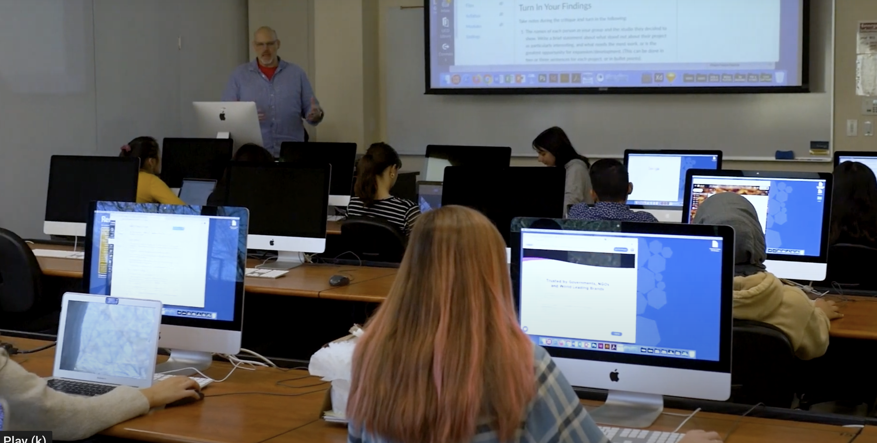
25-Student Macbook Pro Instructional Computer Studio

Slide 4
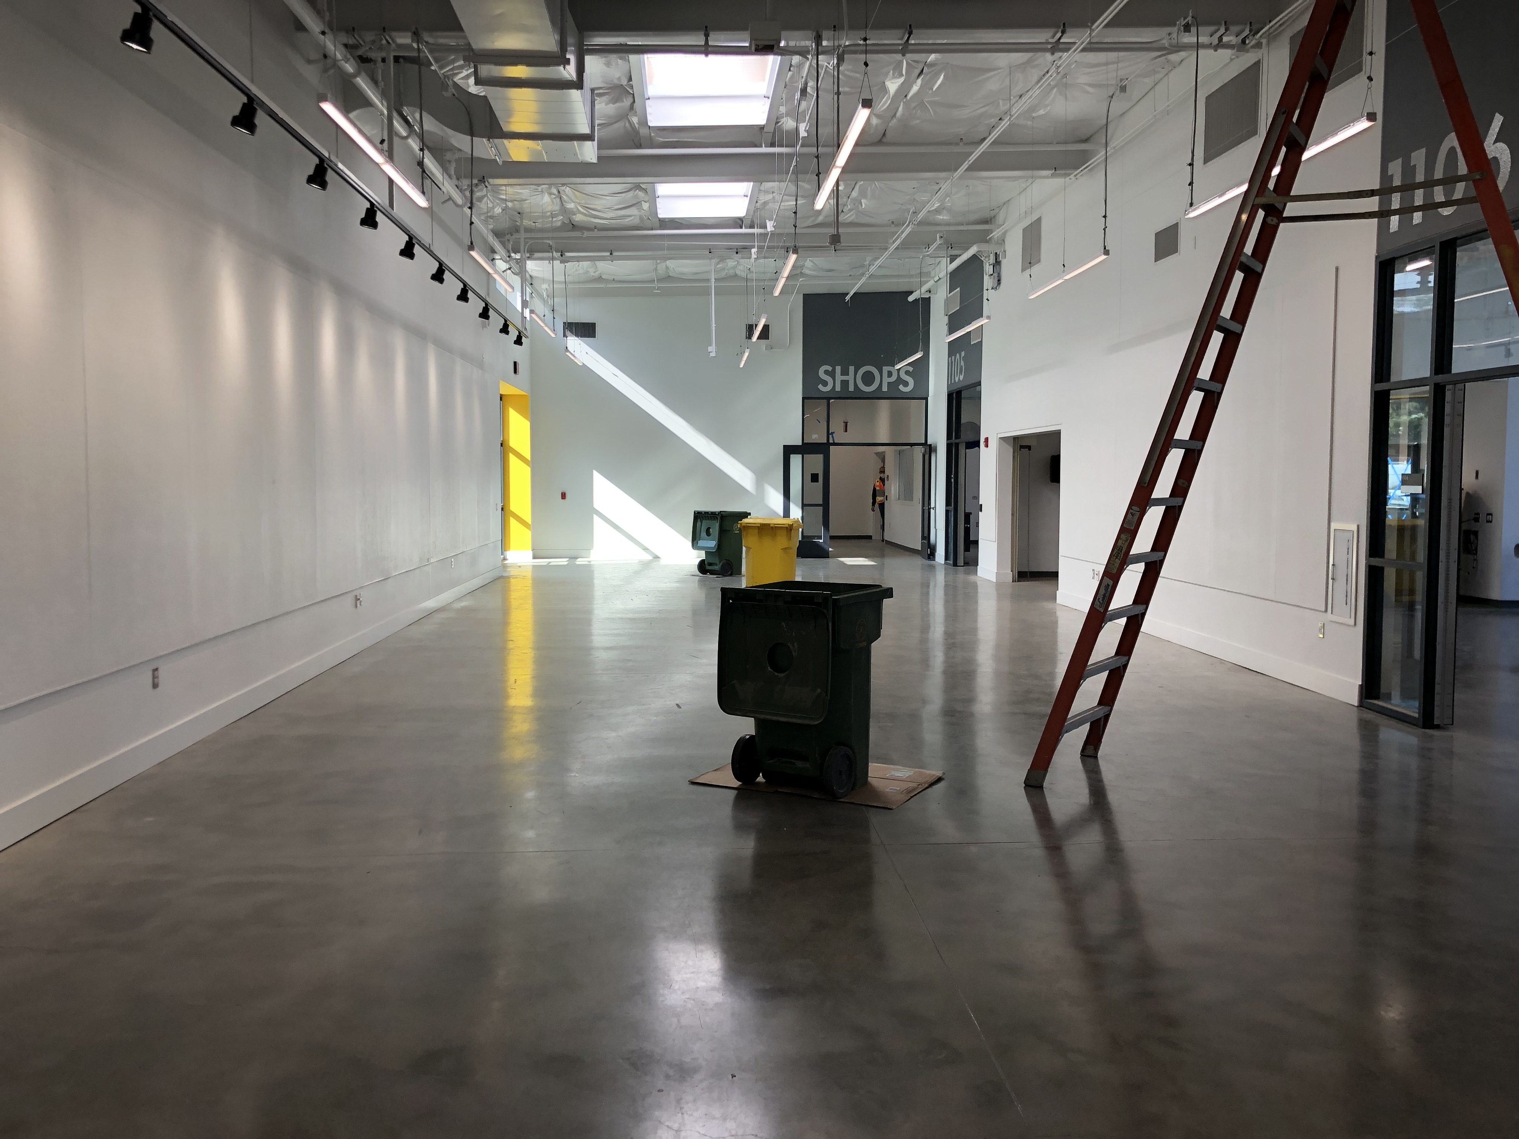
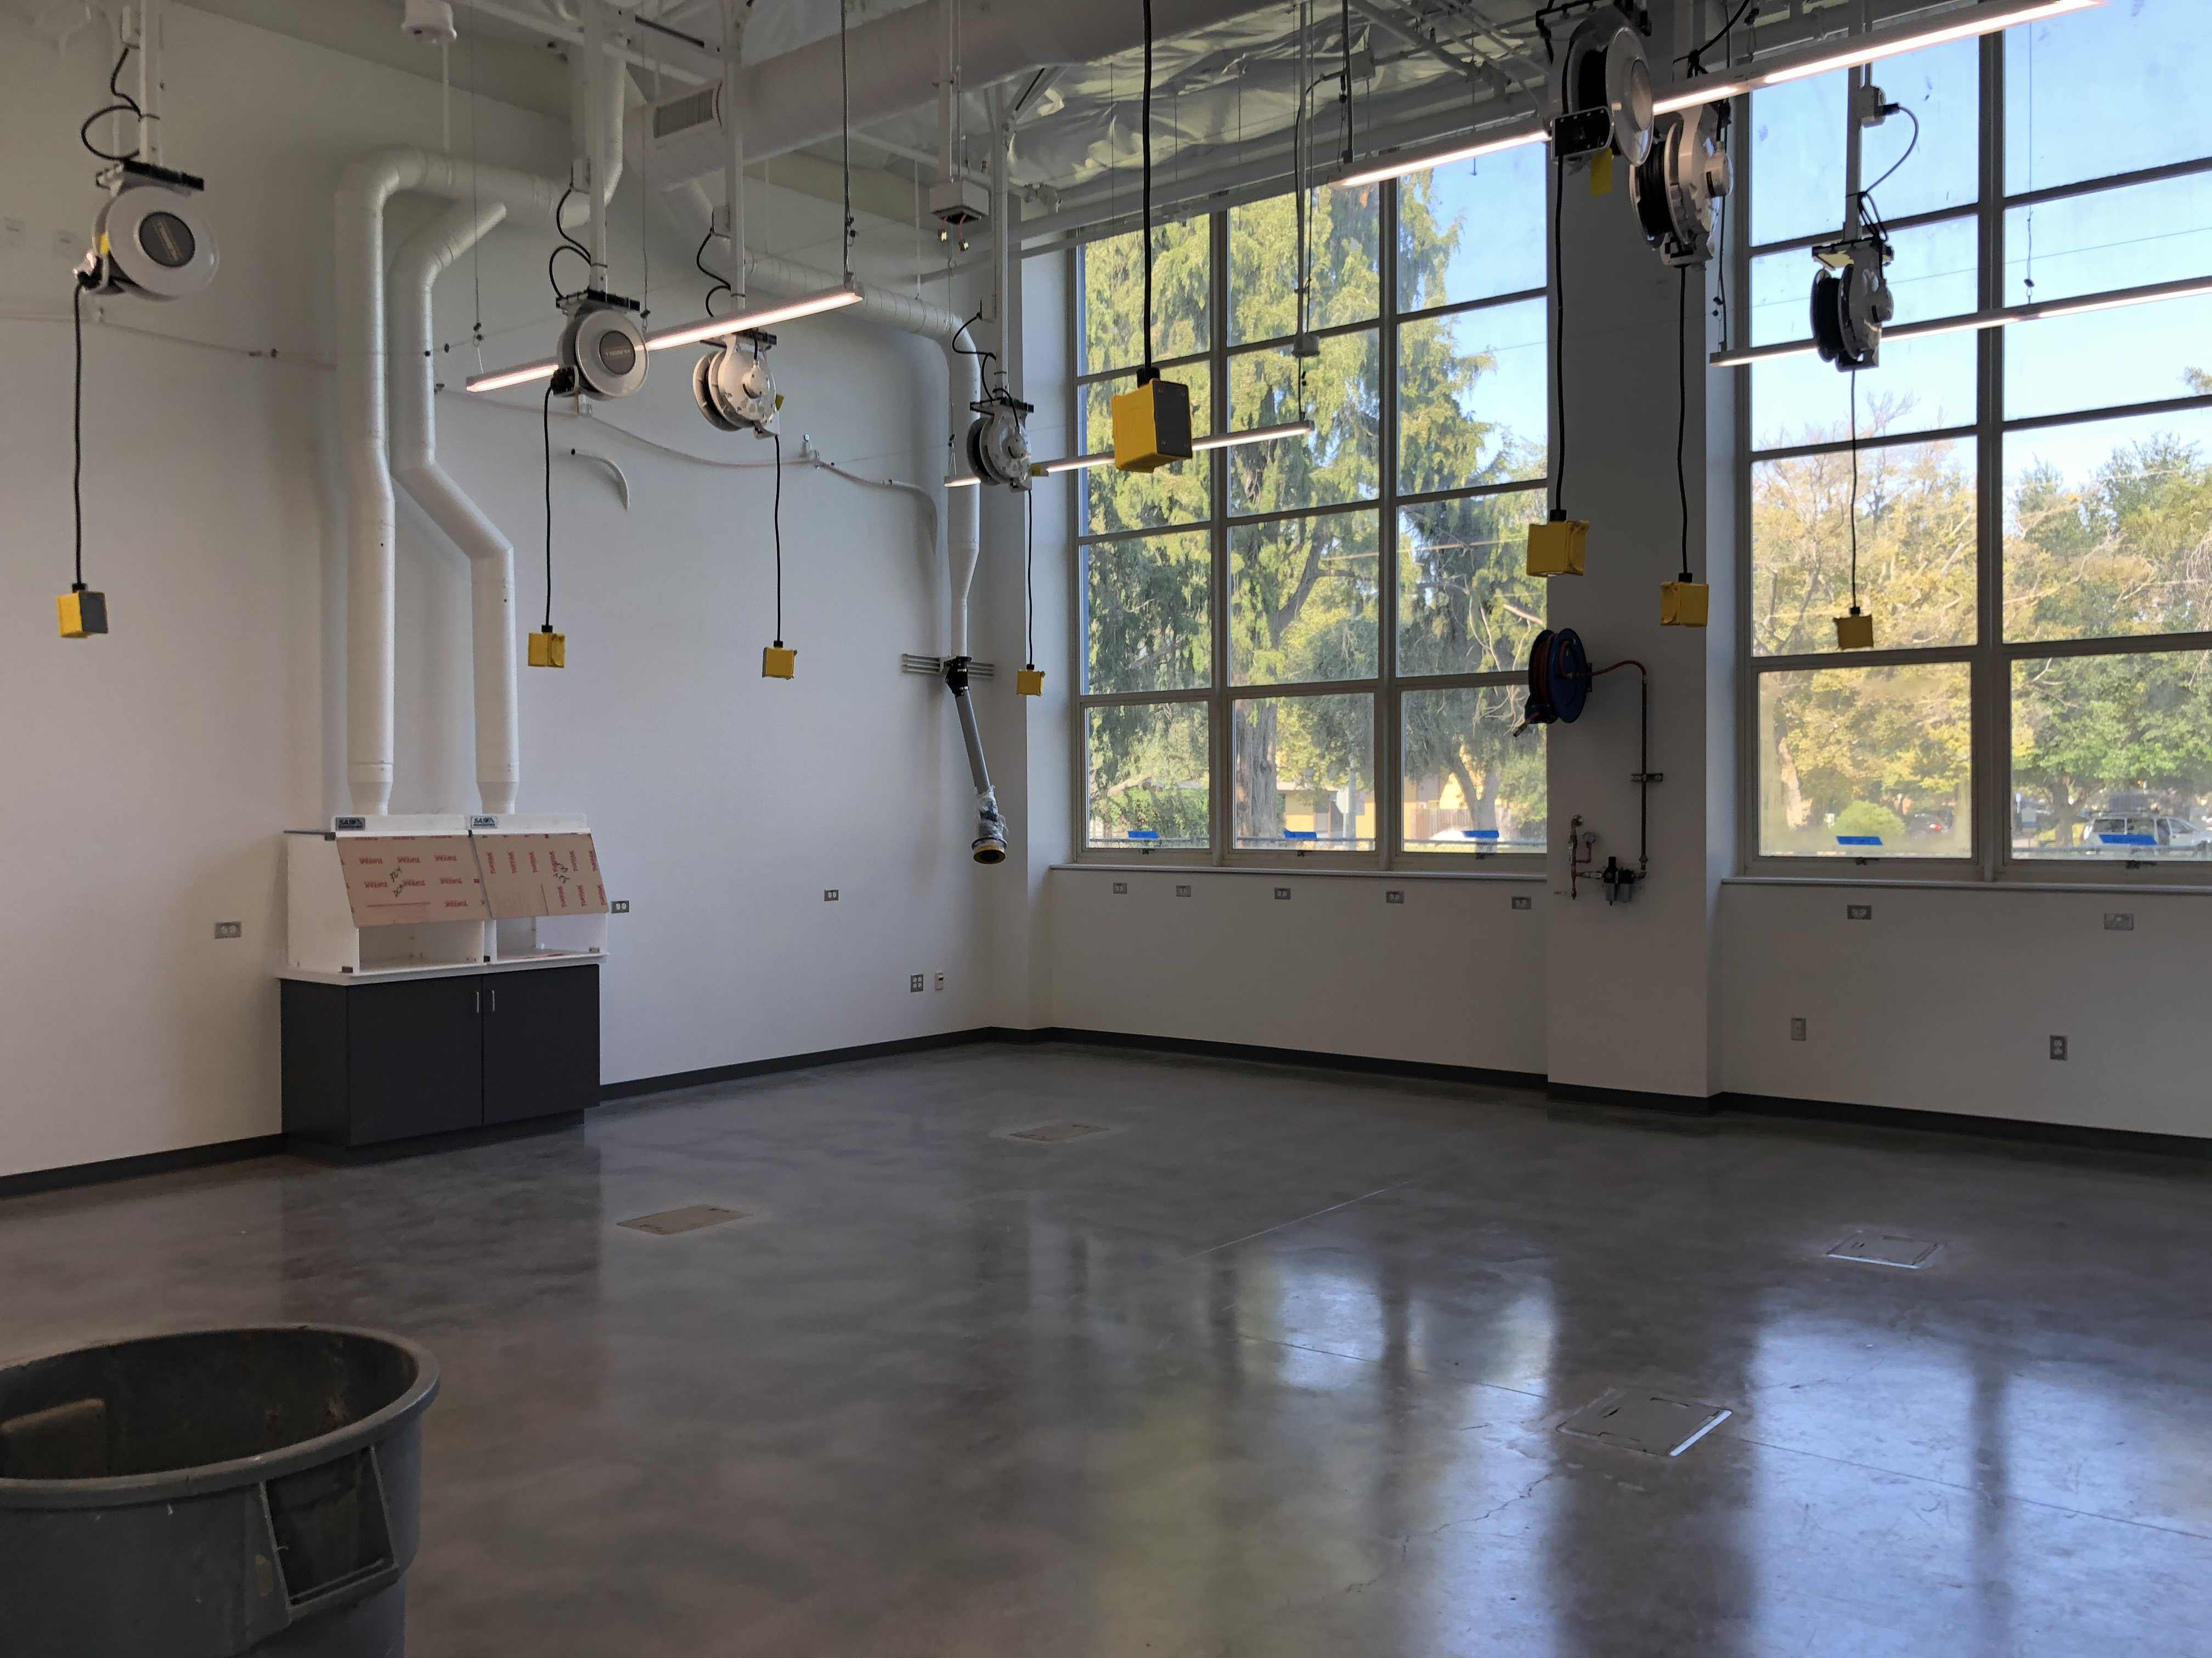
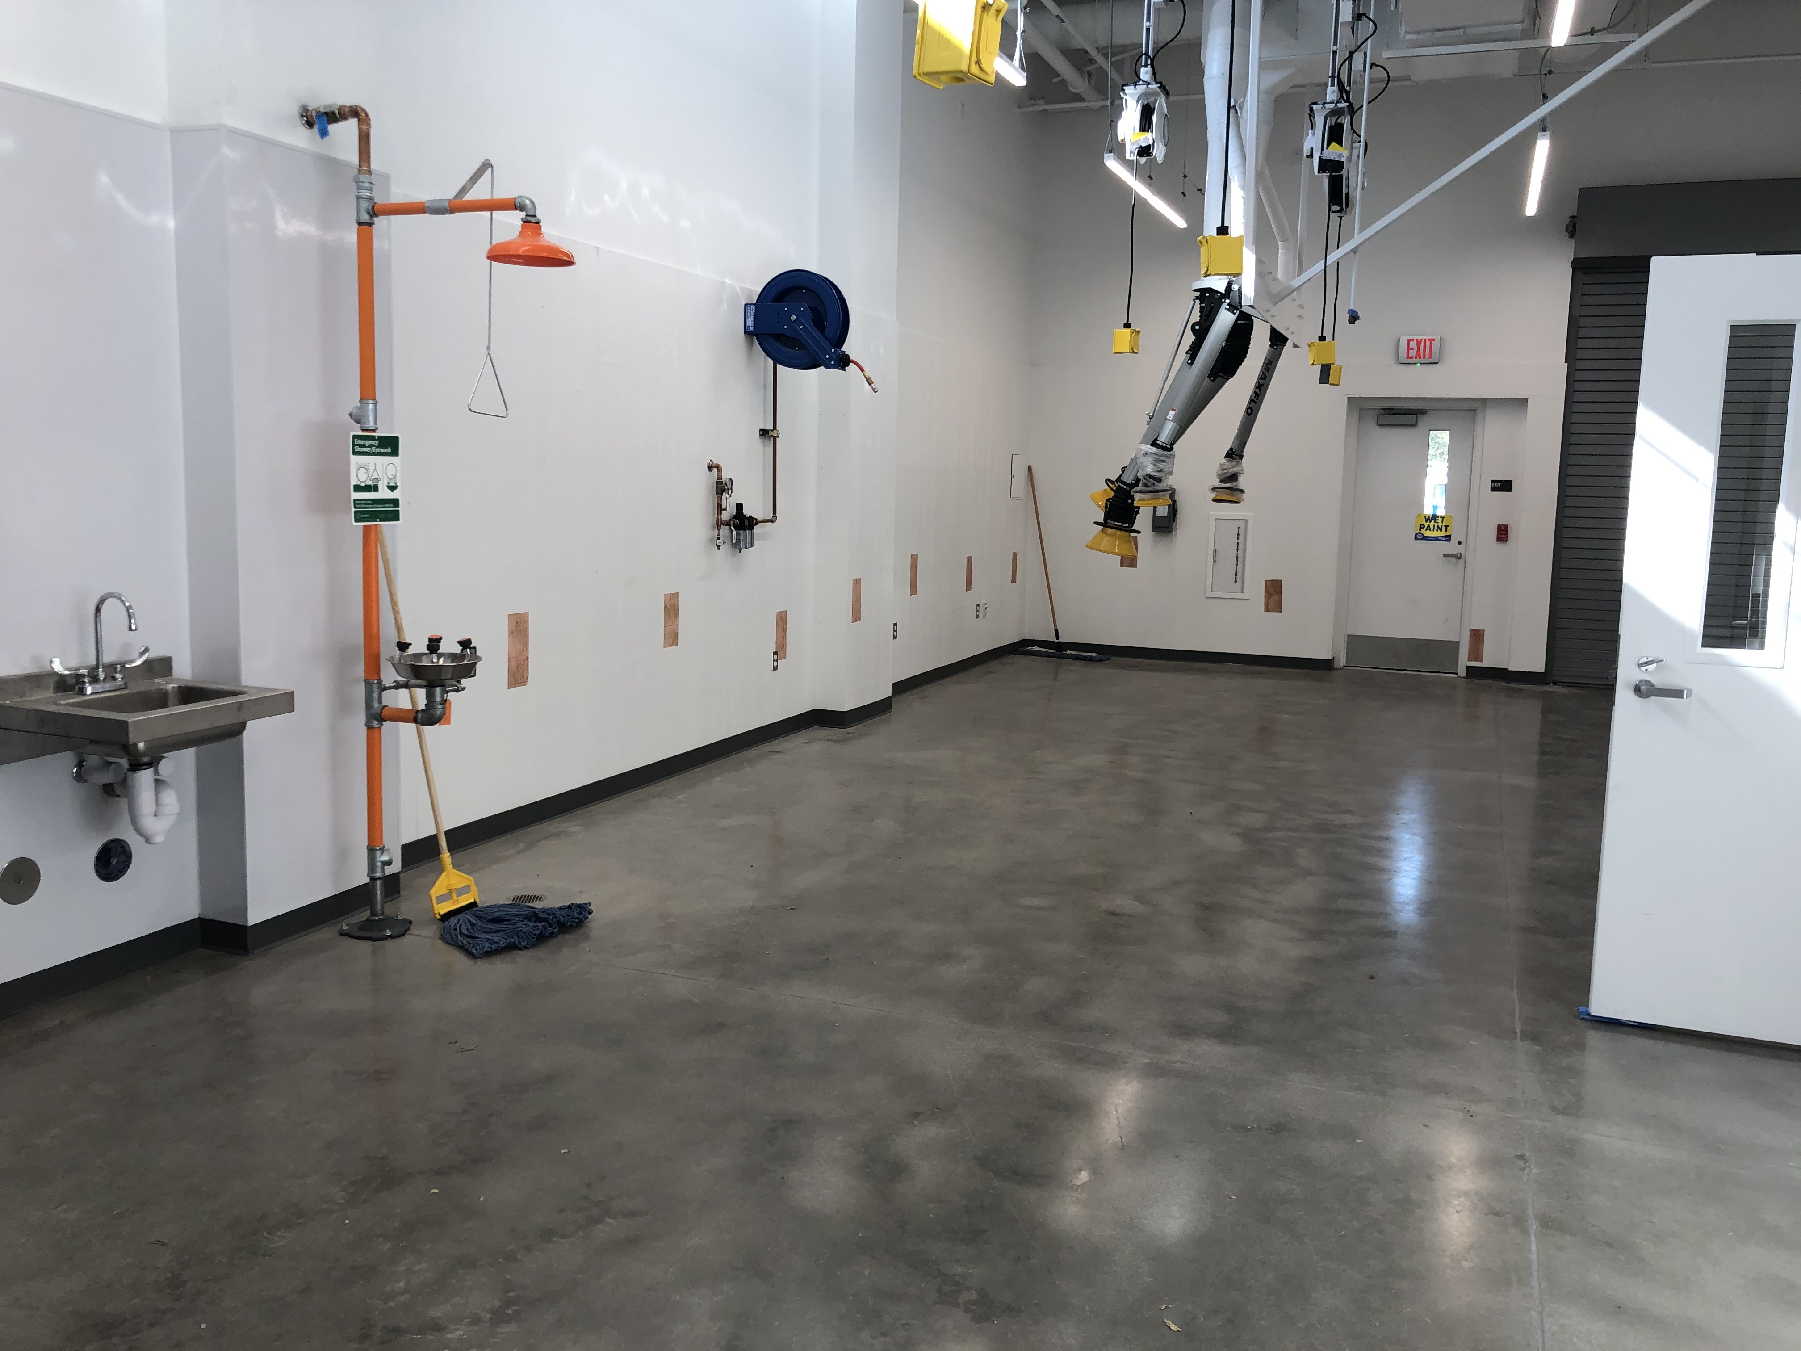
New Makerspace Opening Winter 2021
Woodshop + Metalshop + MediaLab (Arduino + Electronics) + Prototyping Lab

Slide 5
Technology in Our Undergraduate Curriculum
CAD/Coding
DES 111: Coding for Designers
DES 150A: Computer-Assisted Drawing for Designers
Human Computer Interaction
DES 117: Interactive Media
DES 157: Interactive Media II
DES 156 Graphitecture – Architecture in the Age of New Media
DES 168: Interactive Objects
Universal Laser Cutter (32”x18”)
DES 50: Intro to 3D Design
DES 135A: Furniture Design and Detailing
DES 136A and 136B: Lighting Technology and Design
DES 165: Studio Practices in Industrial Design
DES 167: Prototyping: From Objects to Systems
DES 168: Interactive Objects
3D Printing (Ultimaker 2+ Pro or Potterbot)
DES 50: Intro to 3D Design
DES 165: Studio Practices in Industrial Design
DES 167: Prototyping: From Objects to Systems
DES 168: Interactive Objects
CNC
DES 135A: Furniture Design and Detailing
DES 165: Studio Practices in Industrial Design
DES 167: Prototyping: From Objects to Systems
Arduino/Electronics
DES 136A and 136B: Lighting Technology and Design
DES 165: Studio Practices in Industrial Design
DES 168: Interactive Objects
DES 175: Functional Apparel Design
DES 178: Design and Wearable Technology

Slide 6
Technology in Our Undergraduate Curriculum
AR/VR (very little equipment)
DES 150B: Computer-Assisted Presentations for Interior Architecture
Mimaki Digital Textile Printer
DES 161: Textile Surface Design: Screen and Digital Printing
Body Scanner
DES 107: Advanced Structural Design for Fashion
TEAM Biological/Molecular Prototyping Lab
DES 128A and 128B: Biodesign Challenge Theory and Practice
(Design + Biomedical Engineering)
Biosafety Level 1 Lab
Molecular engineering, mammalian and microbial cell culture, protein expression, bioassays, qPCR, microfluidics…
TEAM Biological/Molecular Prototyping Lab

Slide 7
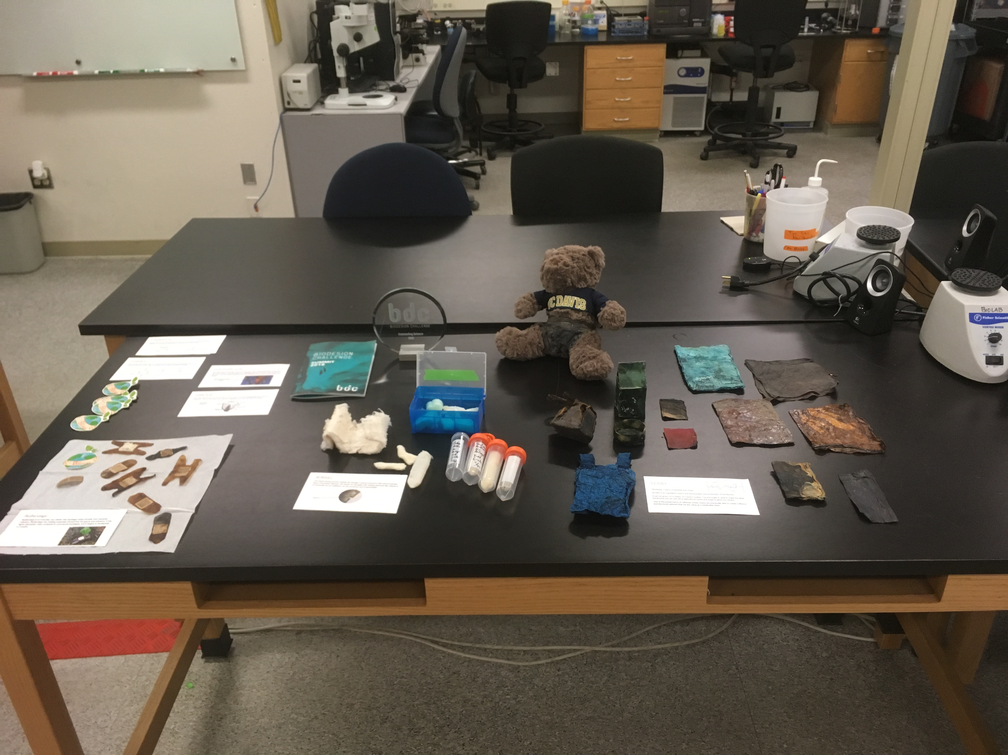
TEAM Biological/Molecular Prototyping Lab
DES 128A and 128B:
Biodesign Challenge
Theory and Practice
Student Team Innovations:
Bacterial Cellulose
Textile & Aerogel for
Biodegradable
Diapers & Bandages

Slide 8
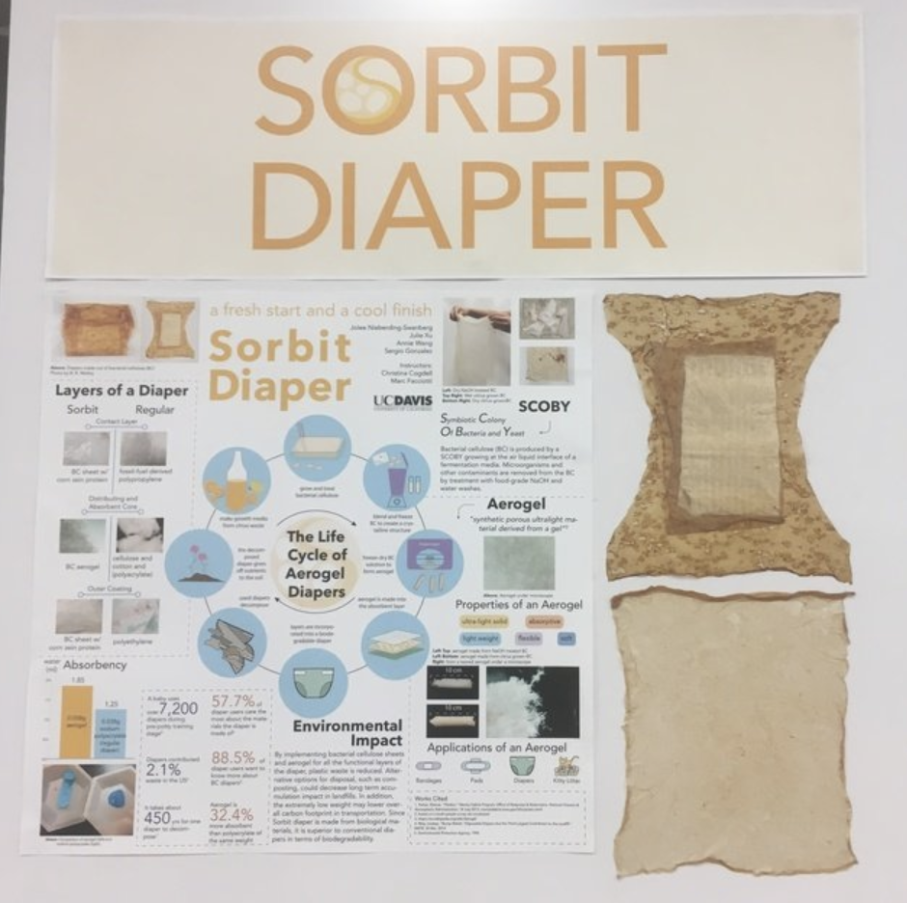
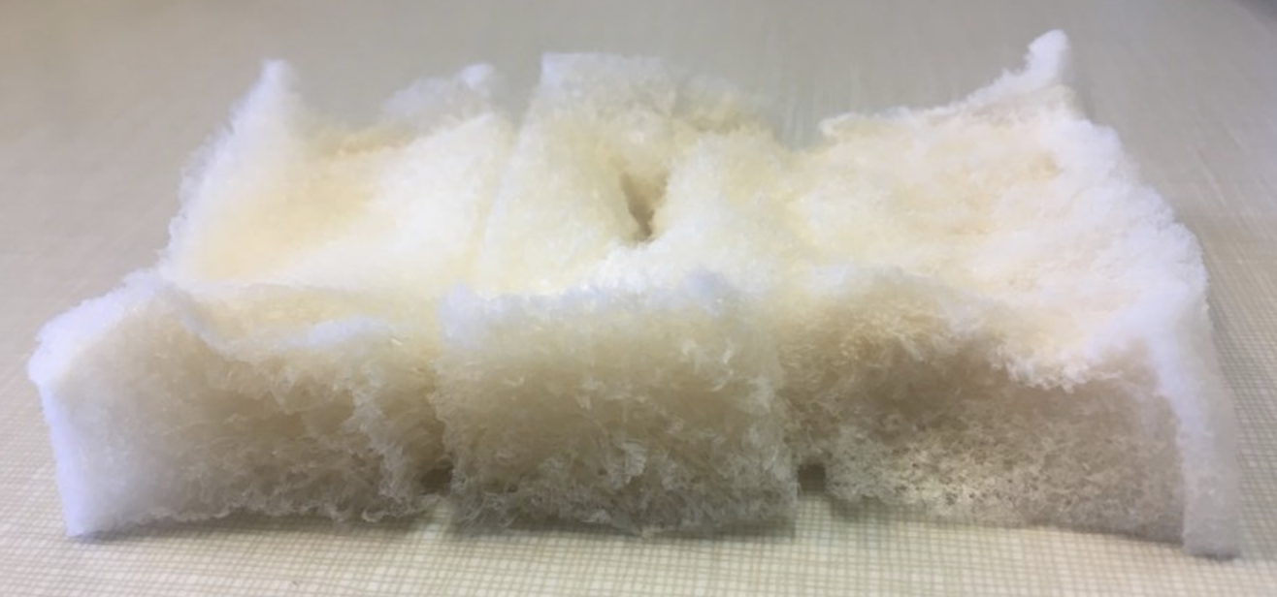
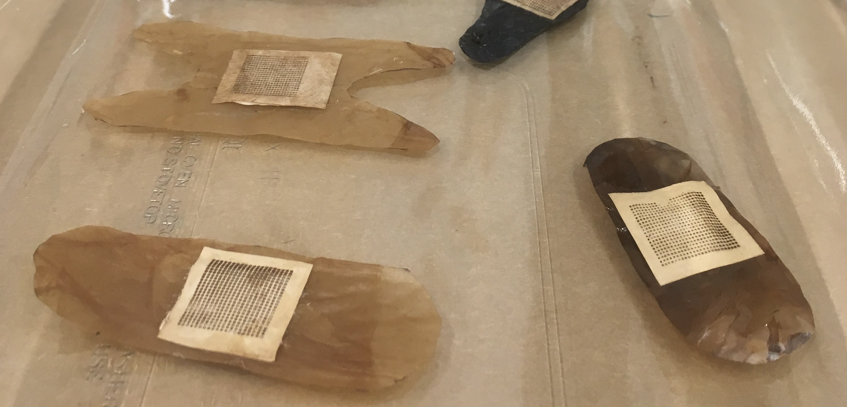
Biodesign Challenge
2-Quarter Course (DES 128A/B)
Undergraduate Student Innovation
Compostable Diaper and Bandages

Slide 9
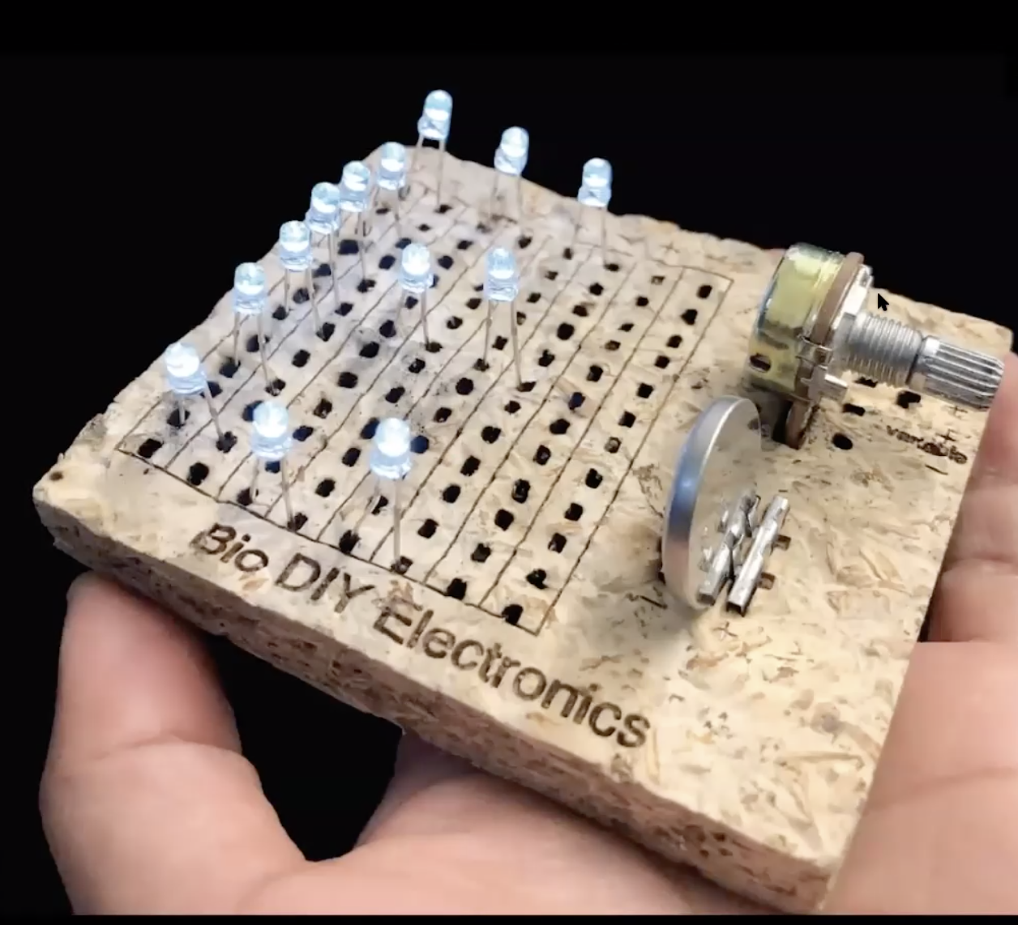
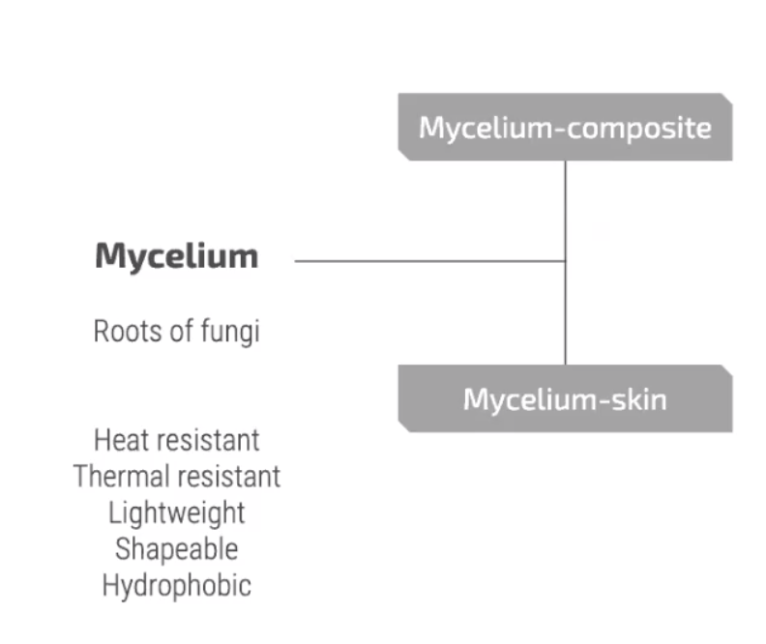
Sustainable Prototyping
for Digital Fabrication
And Human-Computer Interaction
Eldy Lazaro-Vazquez, MFA student

Slide 10
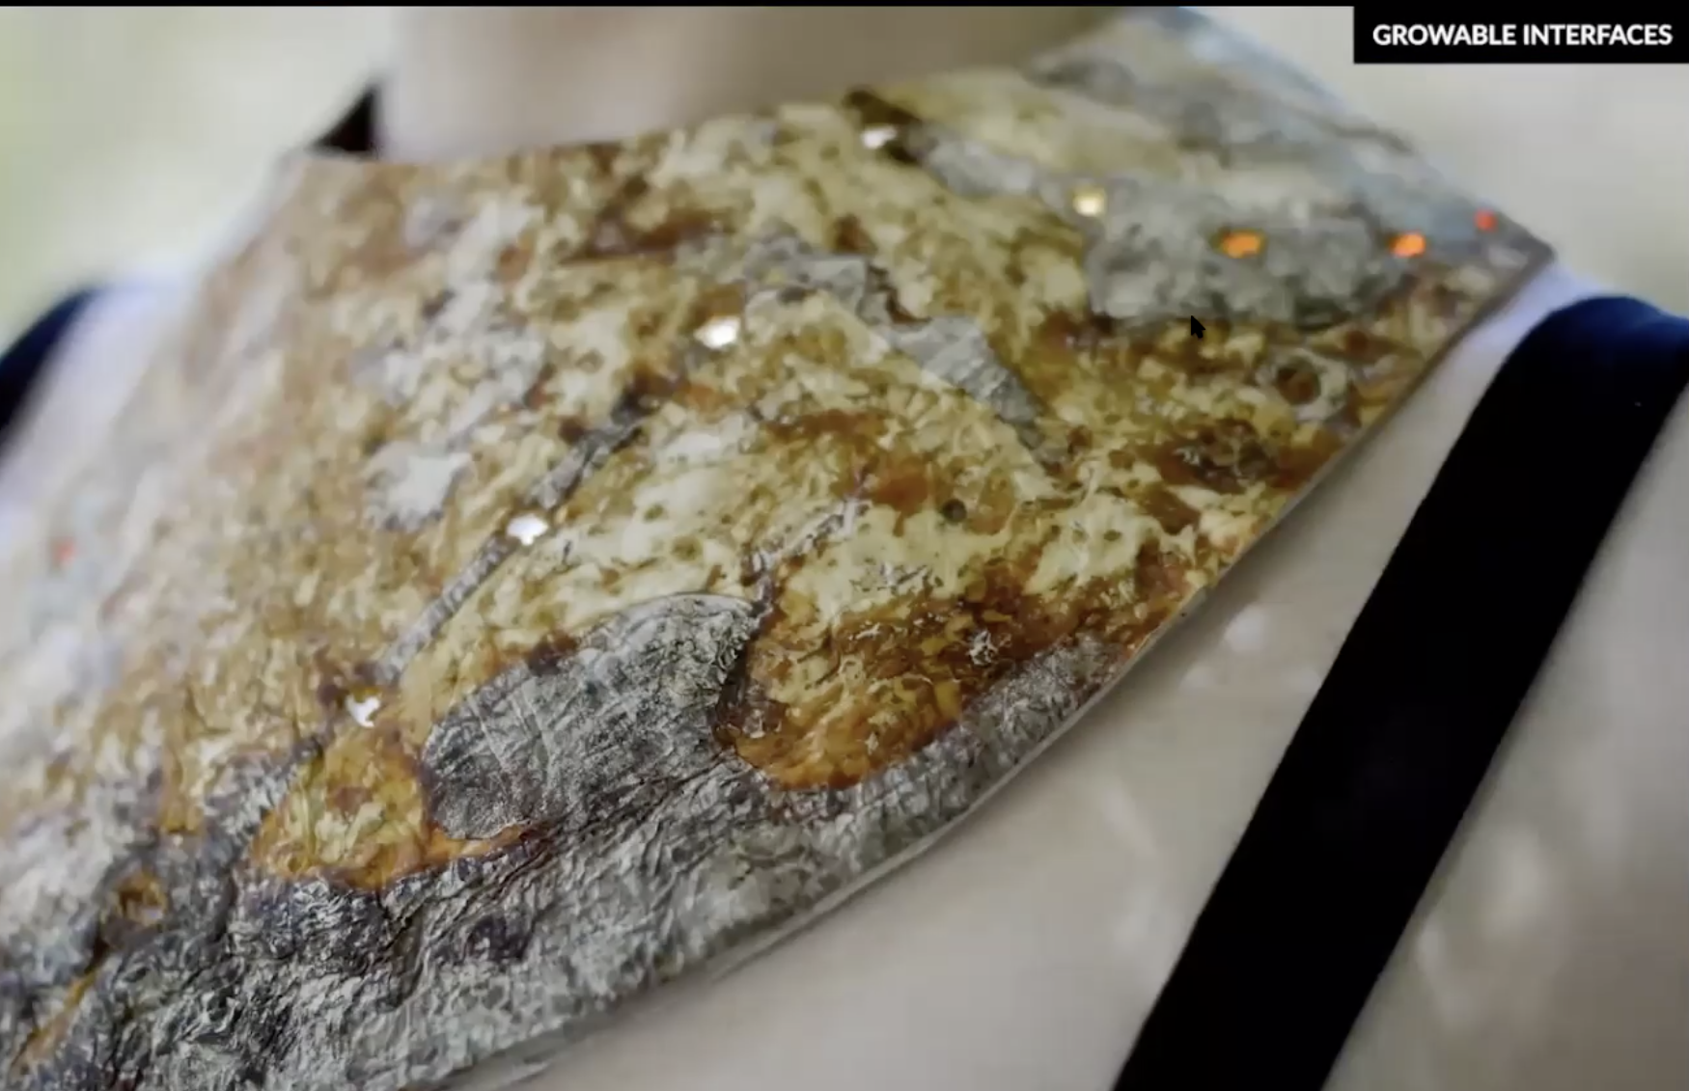
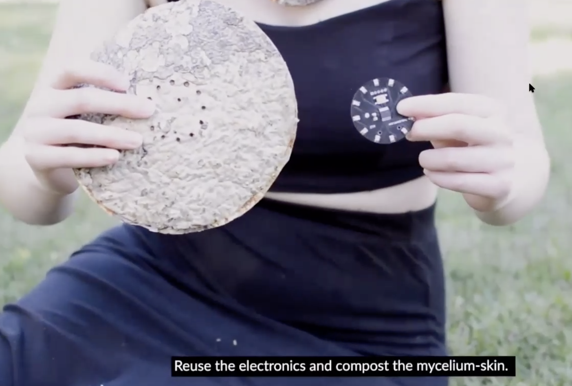
Sustainable Prototyping
for Digital Fabrication
And Human-Computer Interaction
Eldy Lazaro-Vazquez, MFA student
Wearable Technology
Mycelium Skin Embedded with Arduino + Electronics

Slide 11
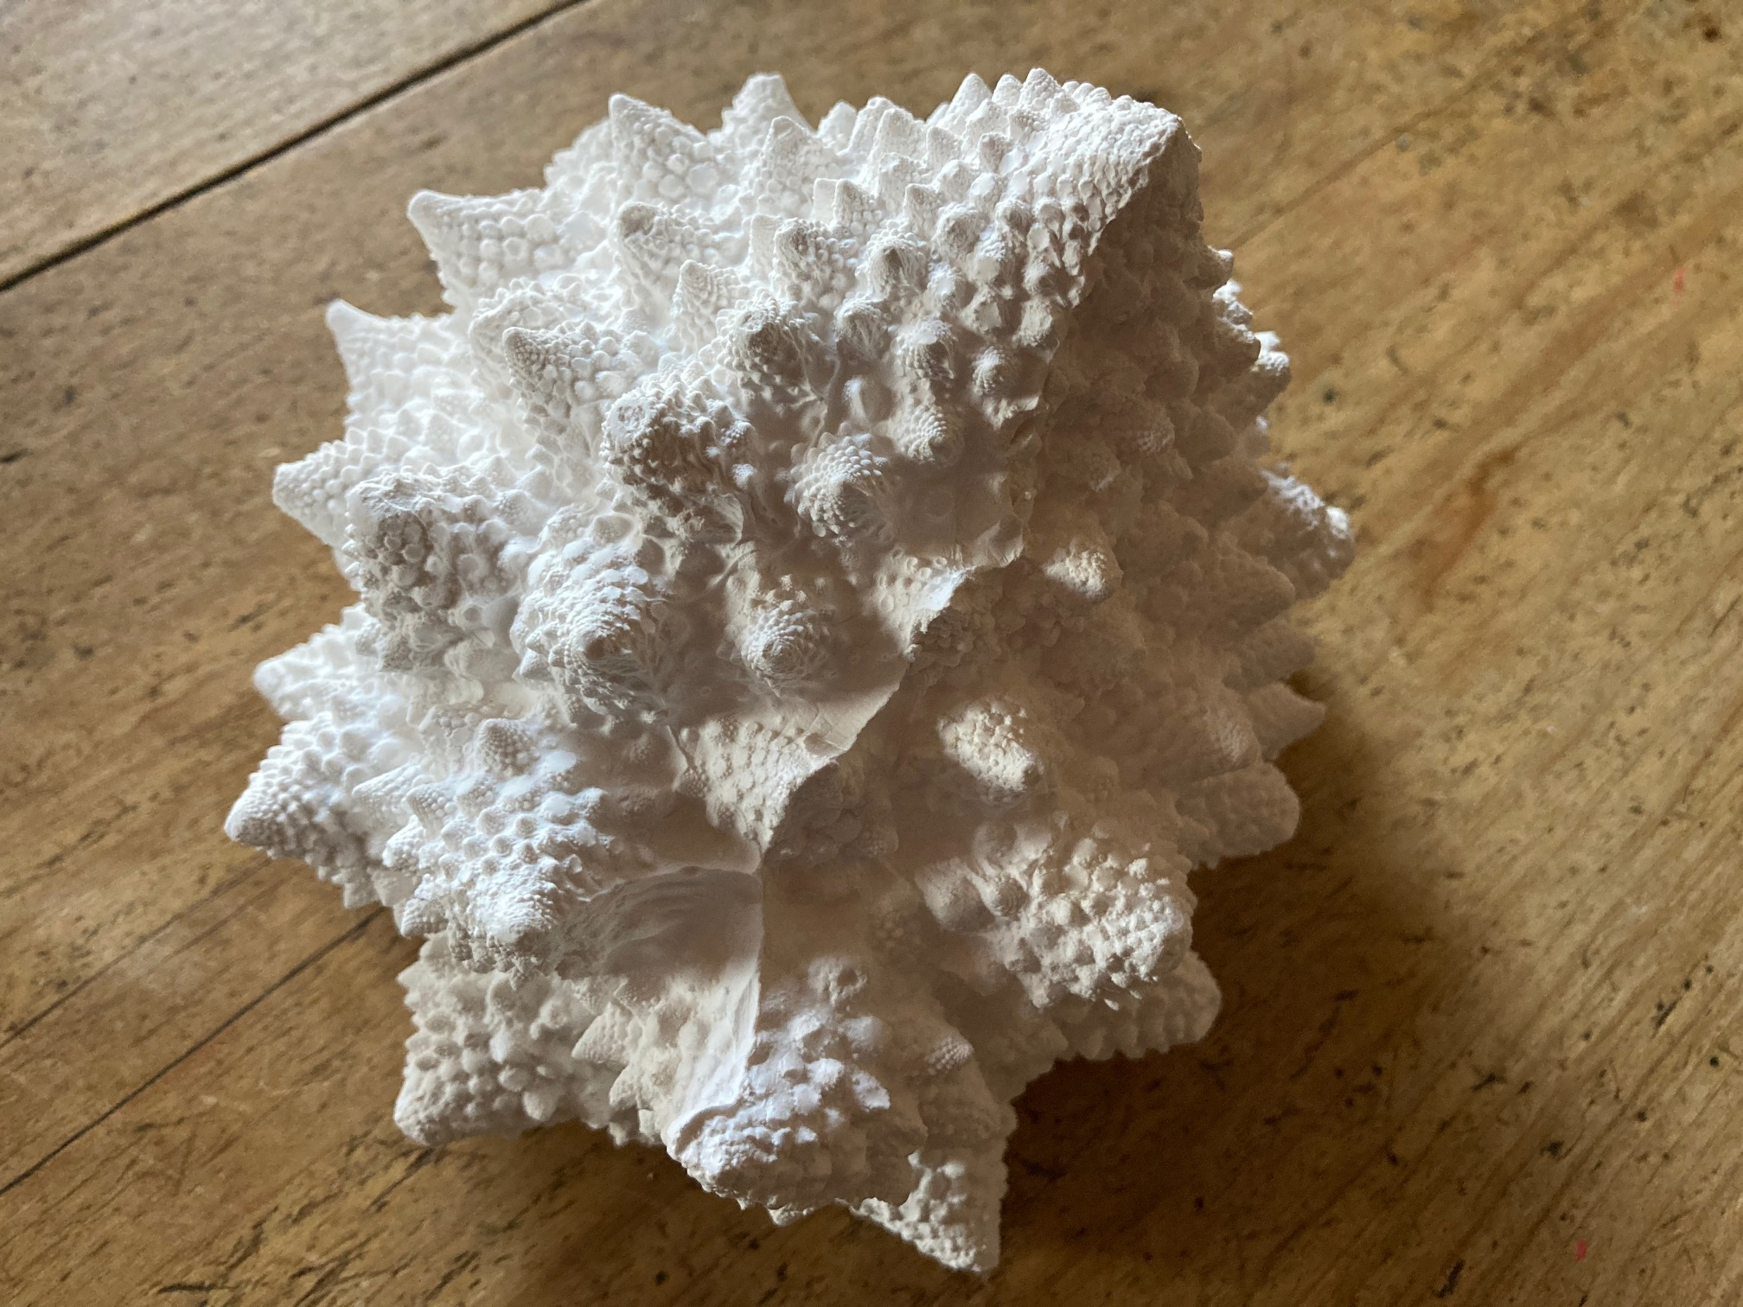
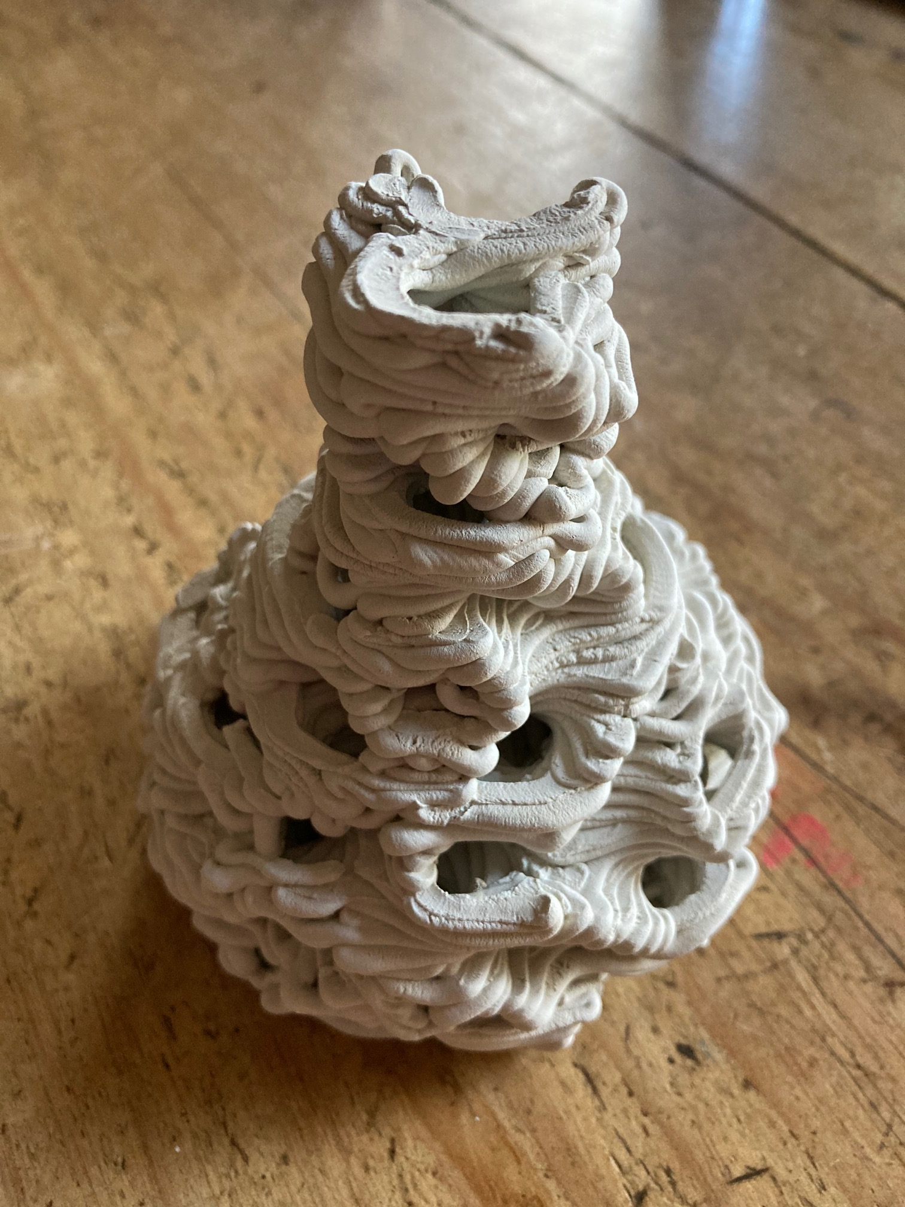
3D Printing – Ultimaker 2+ and PotterBot Clay Extrusion

Slide 12
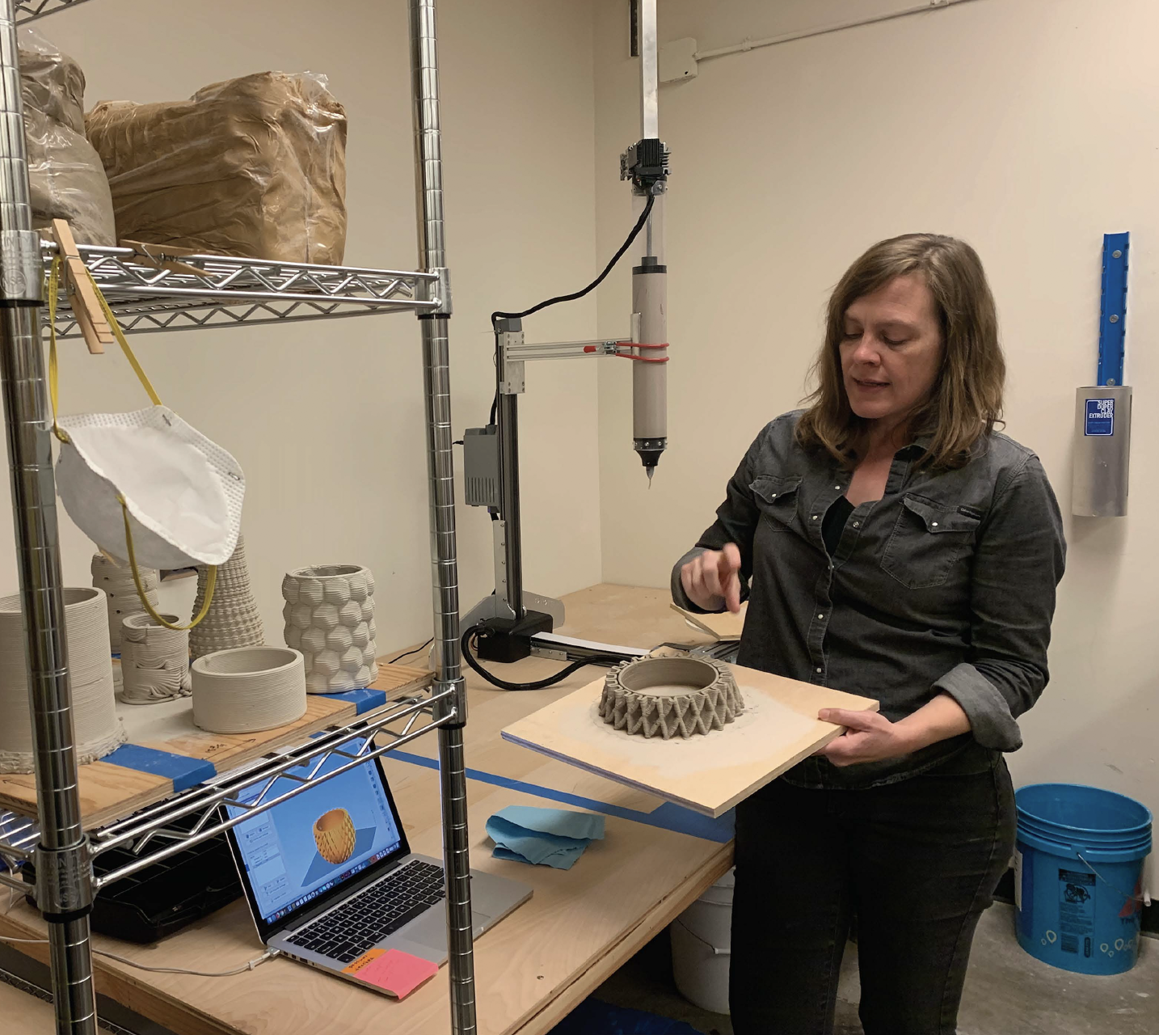
Biodesign for Bioremediation
Microfluidics + Potterbot 3D Printing
Elizabeth Marley, MFA student

Slide 13
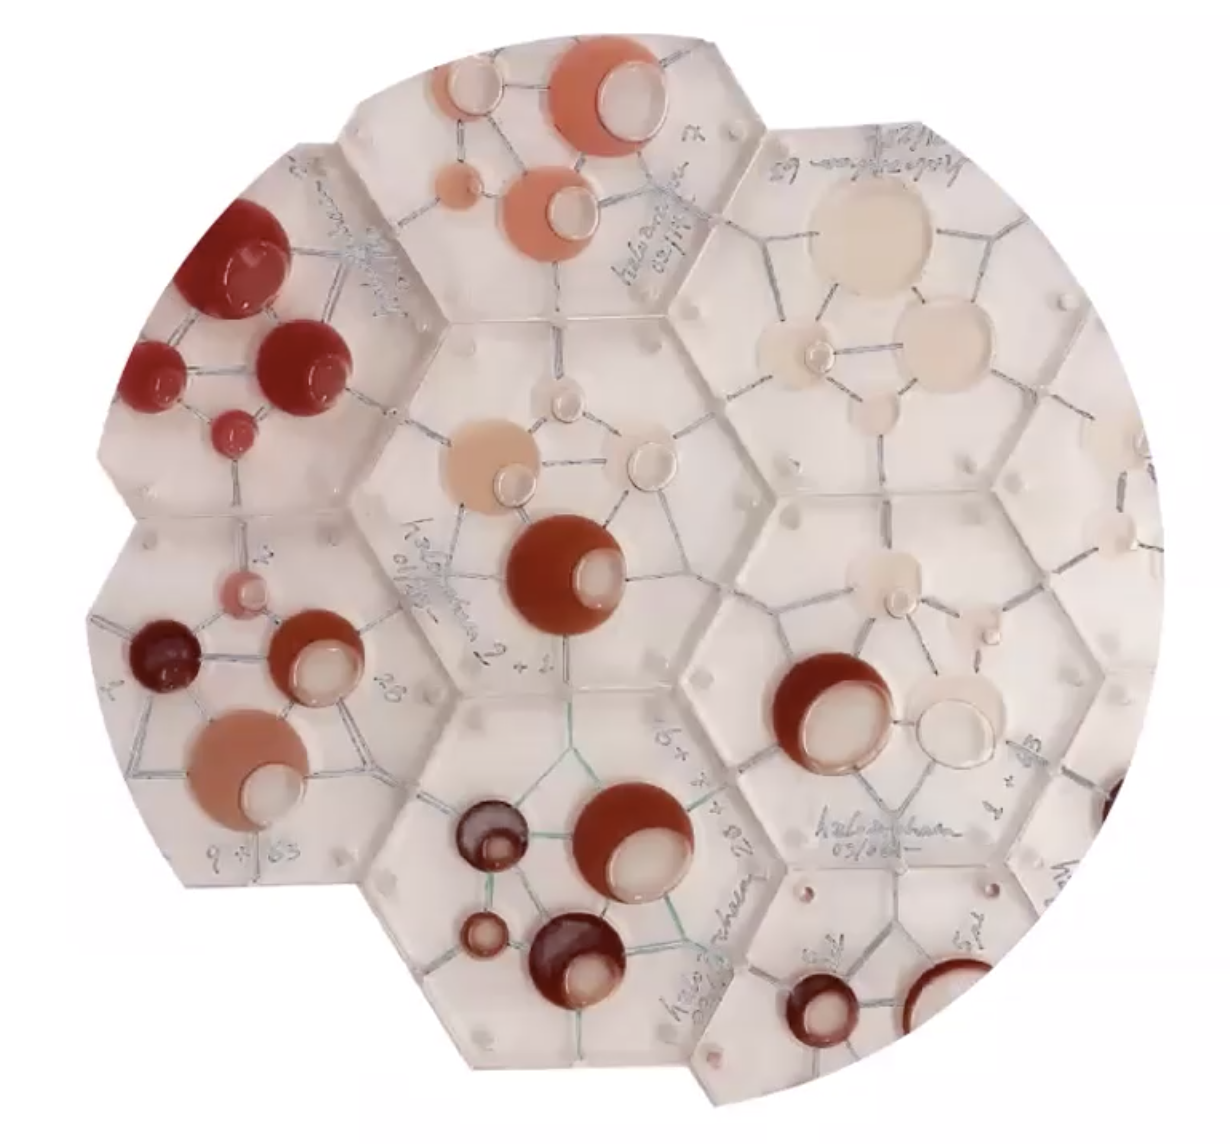
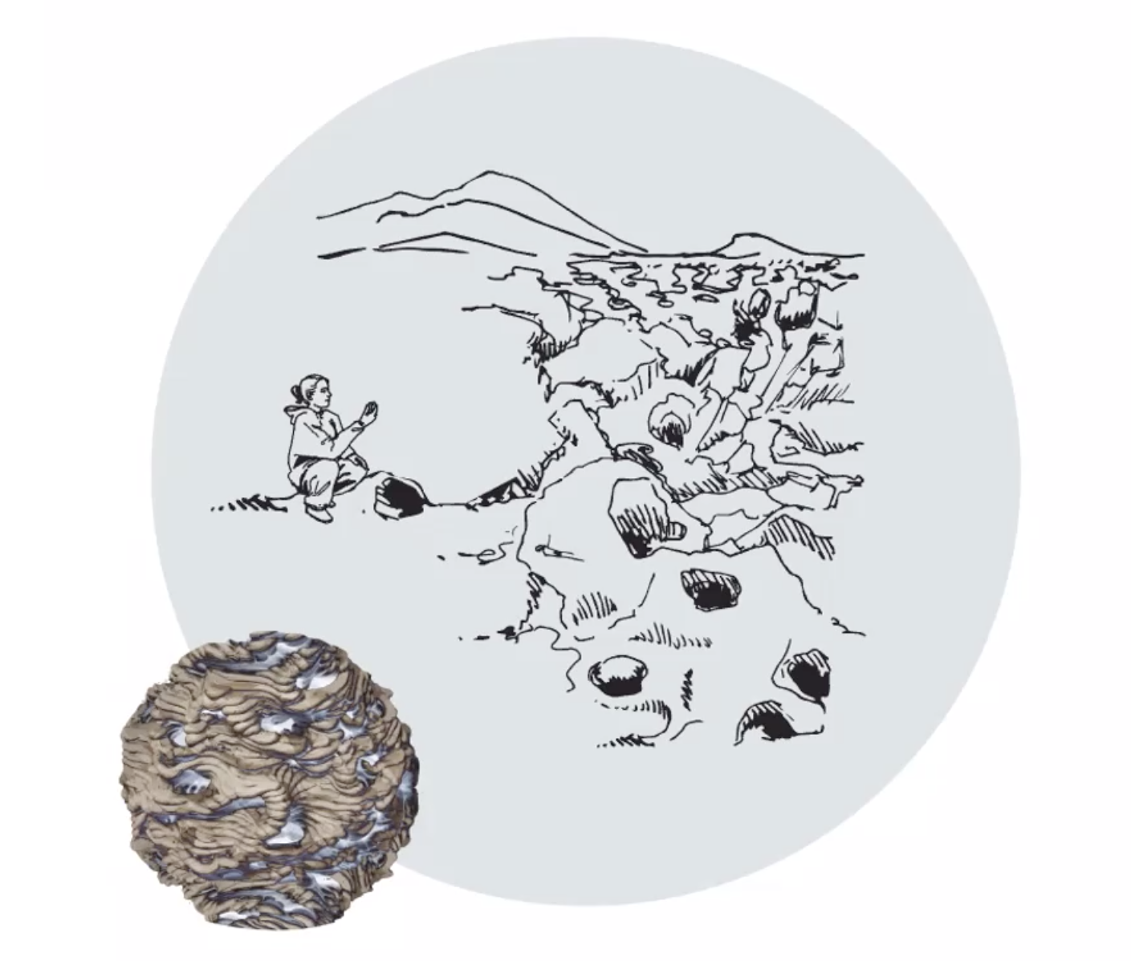
Biodesign for Bioremediation
Microfluidics + Potterbot 3D Printing
Elizabeth Marley, MFA student

Slide 14
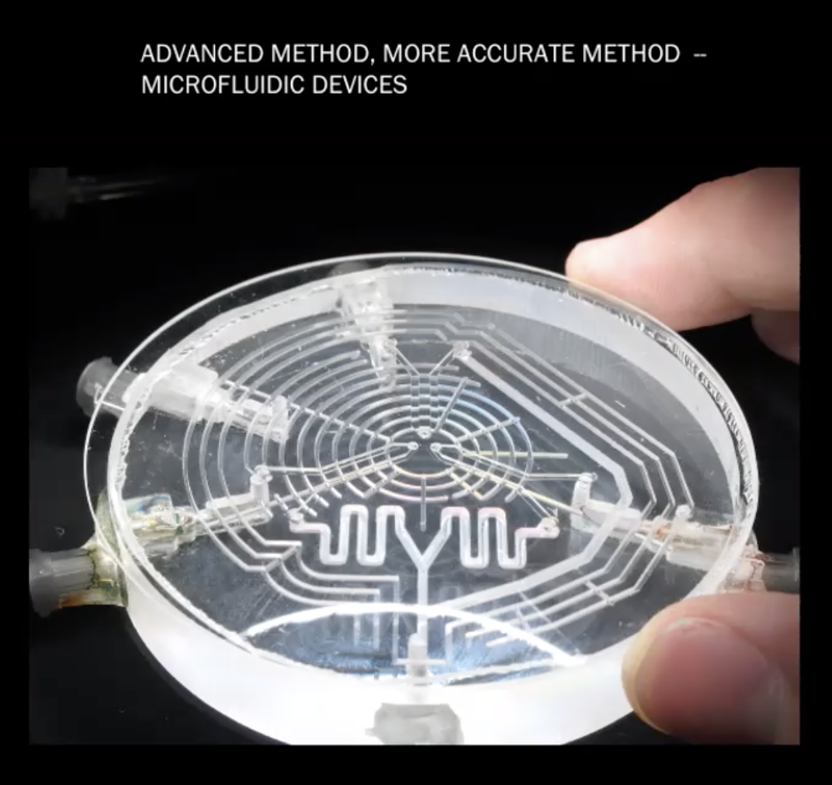
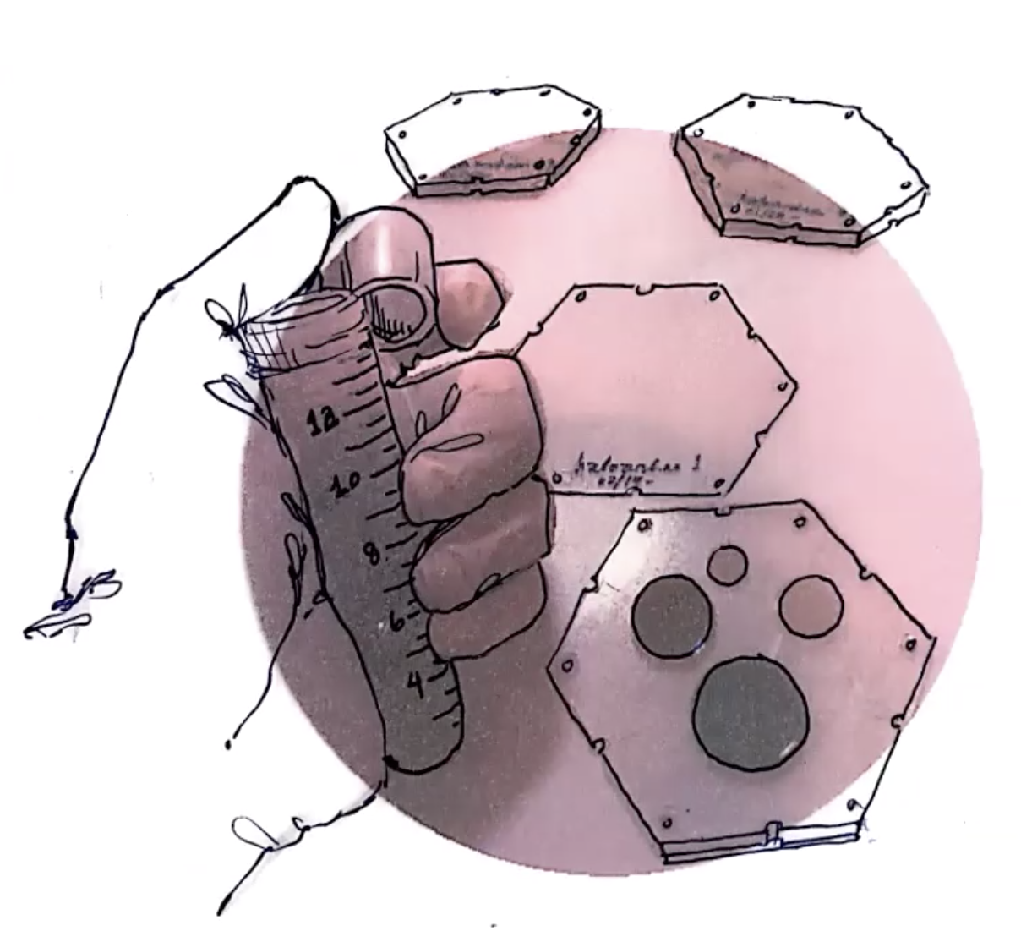
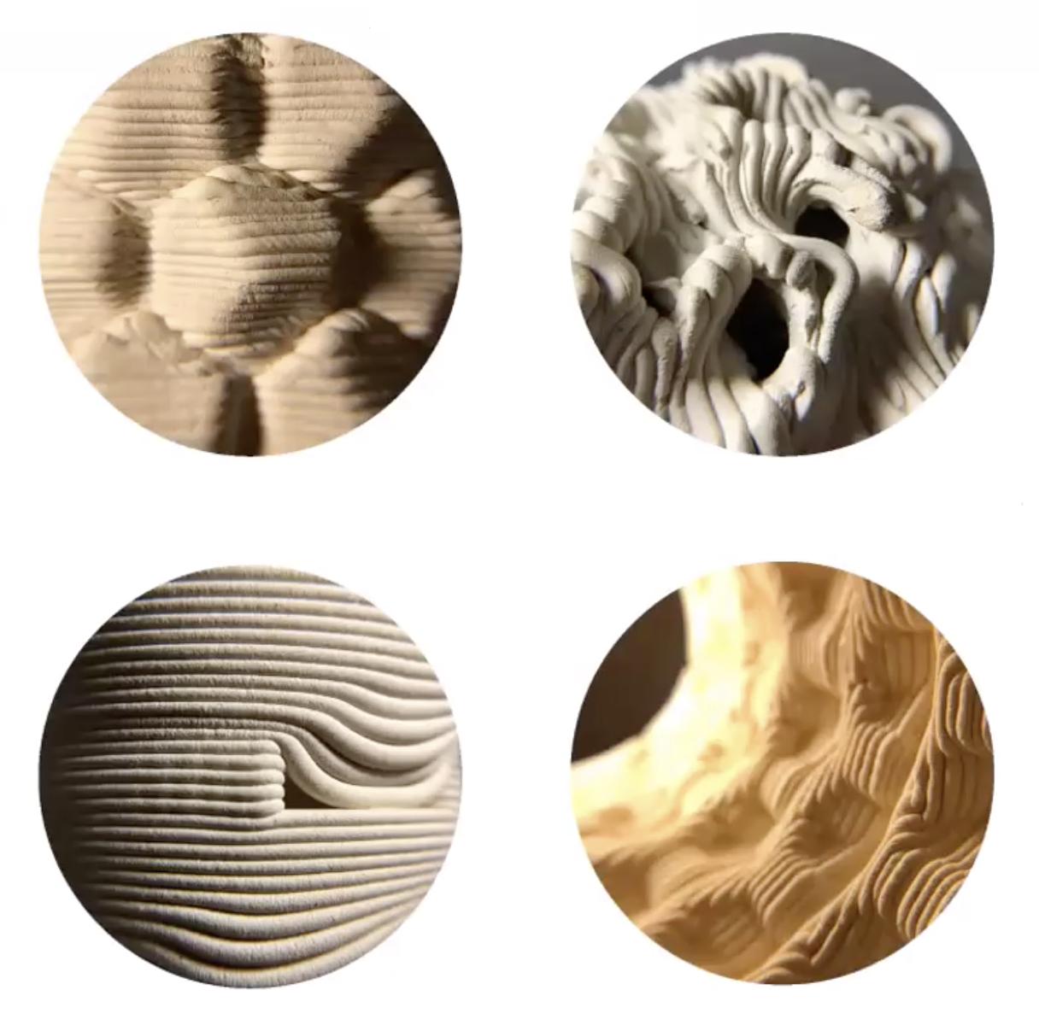
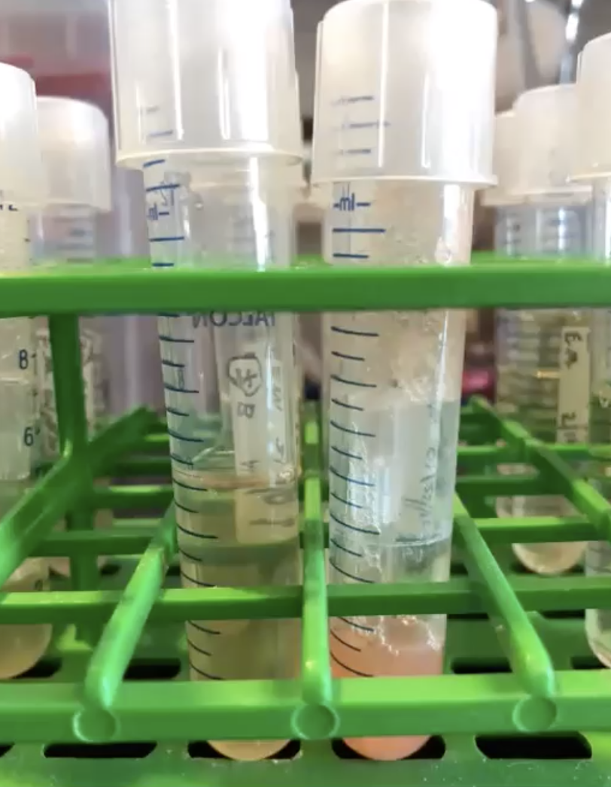
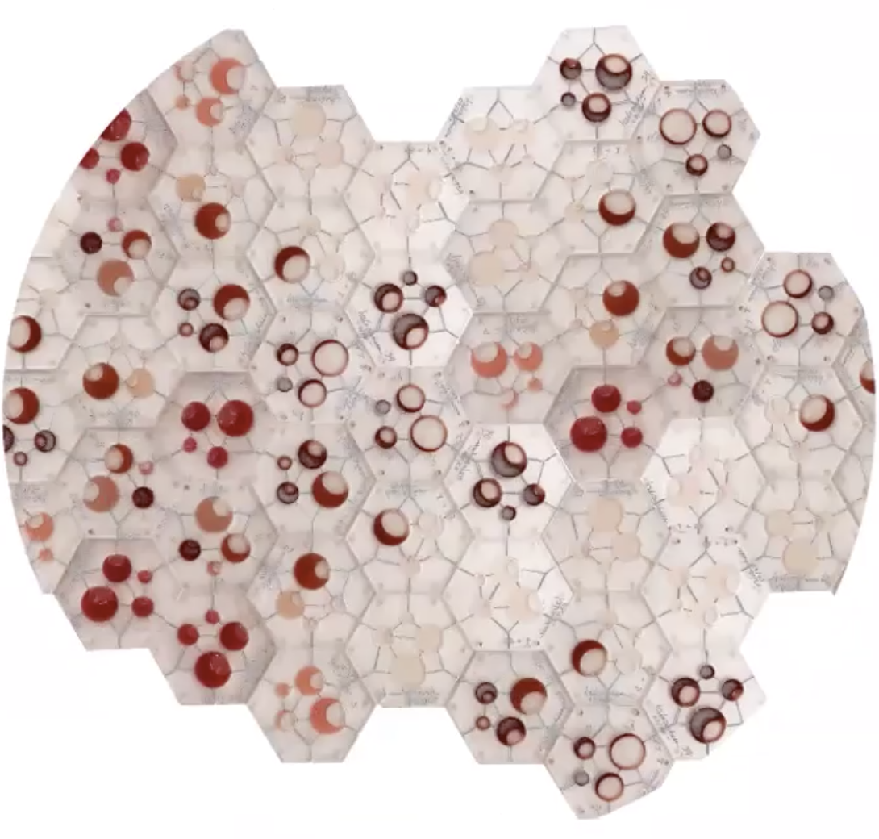
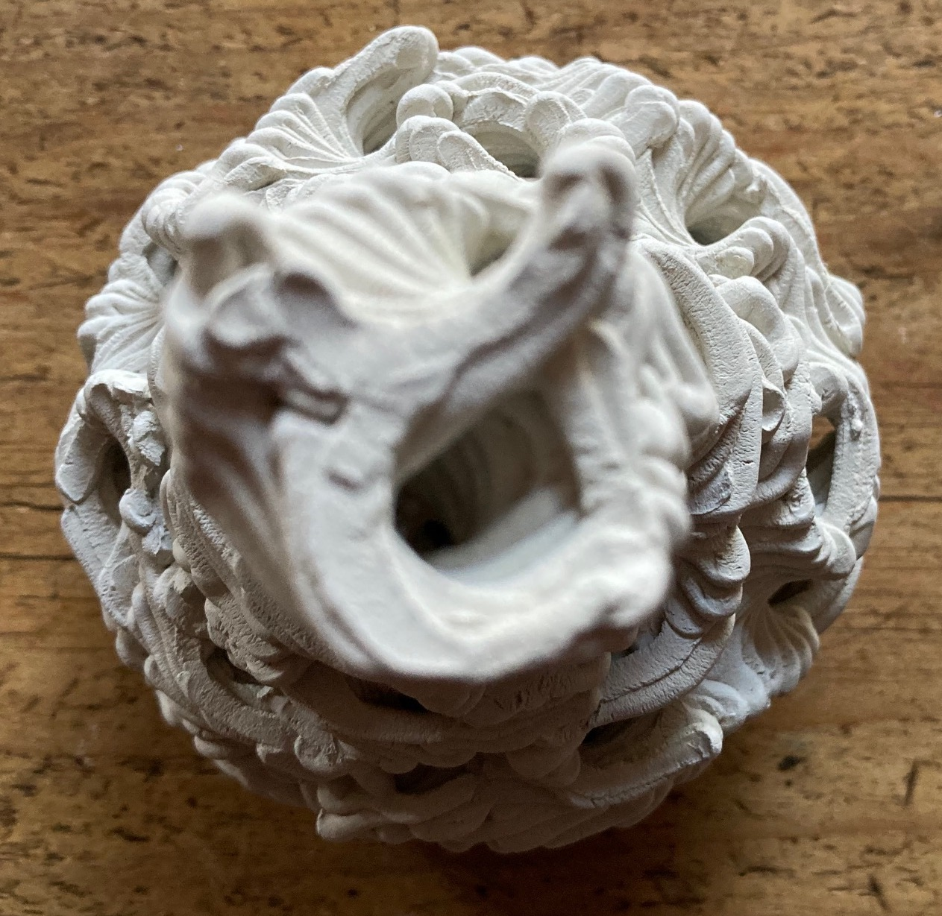
1
3
5
2
4
6

Slide 15
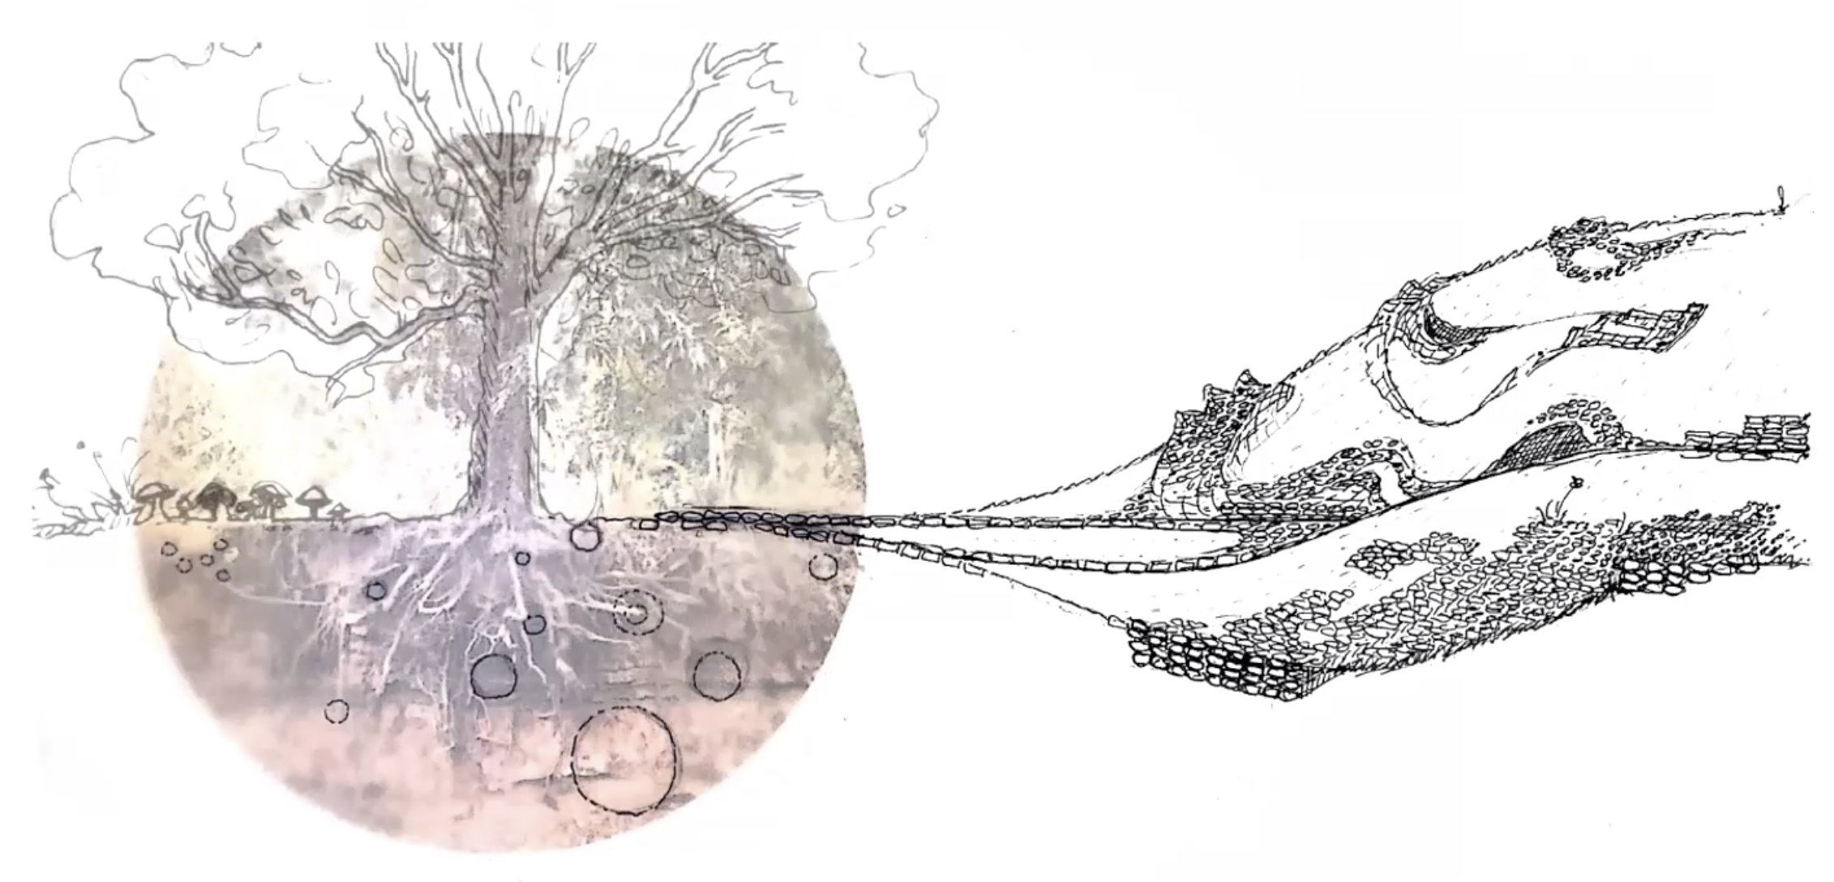

Slide 16
Go ExploraTec!
Thank you!
Dr. Christina Cogdell
cgcogdell@ucdavis.edu

